Slide 1
Identifying and Explaining Film Techniques

Slide 2
Film Analysis
Much like how a writer uses stylistic devices to achieve specific effects in their writing, directors use cinematic techniques in their films for specific purposes.
In order to analyse a film through critical viewing like you do a text in critical reading, you must understand the tools that filmmakers use to create their visual masterpieces.

Slide 3
SHOTS and FRAMING, CAMERA ANGLES and CAMERA MOVEMENTS
All compare to how a writer uses POINT OF VIEW
Shot: a single piece of film uninterrupted by cuts
Of course, different shot types, angles and movements achieve different effects

Slide 4
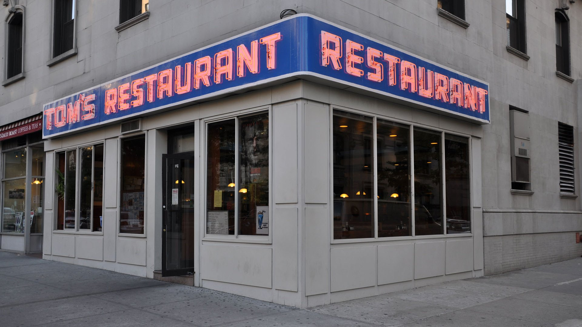
ESTABLISHING SHOT - Often a long shot or a series of shots that sets the scene; it used to establish setting and to show transitions between locations
From the TV Show “Seinfeld”

Slide 5
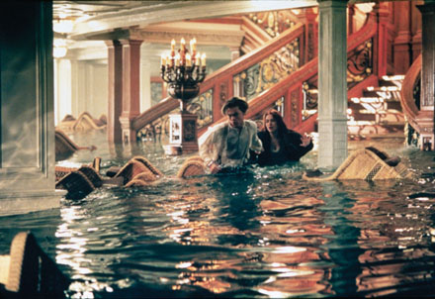
LONG SHOT – a short from some distance. If filming a person, the full body is shown. It may show the isolation or vulnerability of the character
From the movie “Titanic”

Slide 6
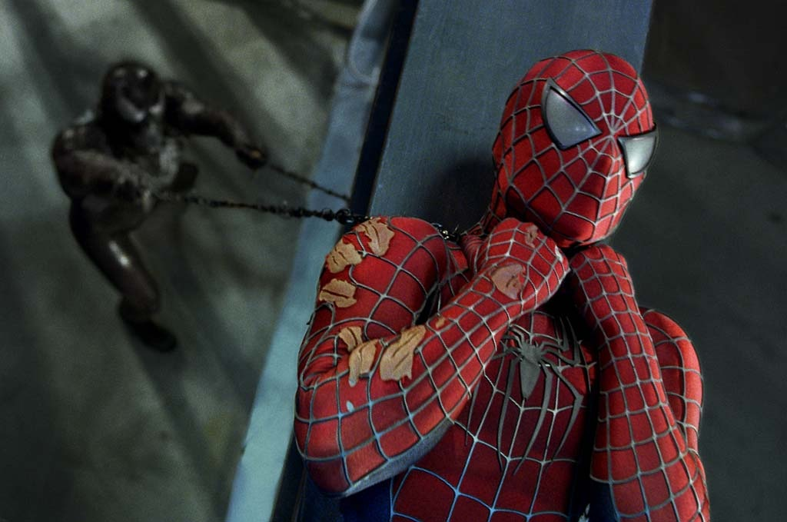
MEDIUM SHOT – the most common shot. The camera seems to be a medium distance from the object being filmed. A medium shot shows the person from the waist up. The effect is to ground the story.
From the movie “Spiderman 2”

Slide 7
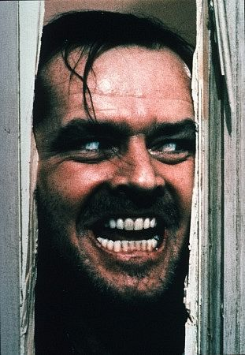
CLOSE UP – the image takes up at least 80 percent of the frame. The effect of this is to highlight or emphasise something, normally a character
From the movie “The Shining”

Slide 8
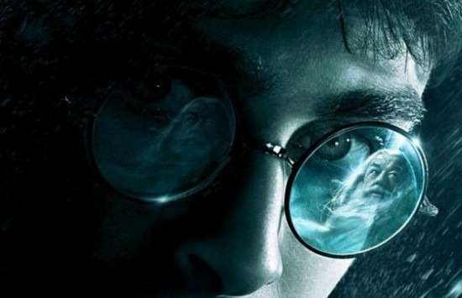
EXTREME CLOSE UP – the image being shot is a part of a whole, such as an eye or a hand; directs the audience to focus on a feature or object.

Slide 9
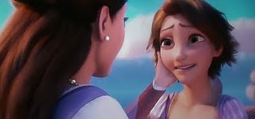
TWO SHOT – a scene between two people shot exclusively from an angle that includes both characters more or less equally. It is used in love scenes where the interaction between two characters is important.
From the movie “Tangled”

Slide 10
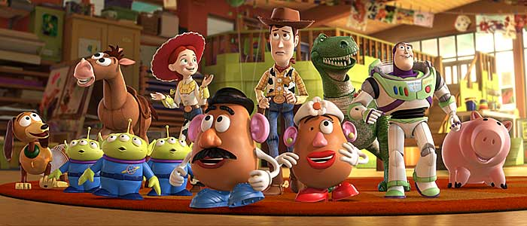
EYE LEVEL – a shot taken from normal height; that is, the character’s eye level. Ninety to ninety-five percent of the shots seen are eye level, because it is the most natural angle. This angle can encourage the audience to feel a part of what they are watching.
From the movie “Toy Story”

Slide 11
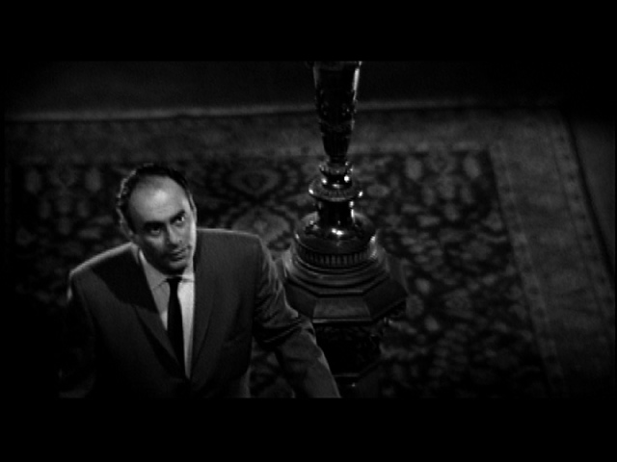
HIGH ANGLE – the camera is above the subject. This usually has the effect of making the subject look smaller than normal, giving him or her the appearance of being weak, powerless or trapped.
From the movie “Psycho”

Slide 12
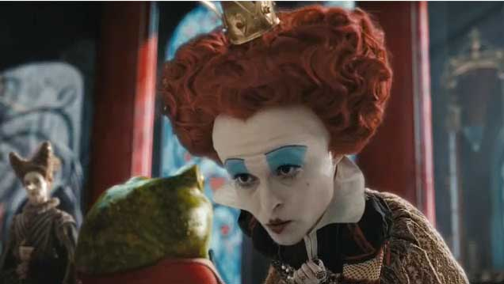
LOW ANGLE – the camera films subject from below. This usually has the effect of making the subject look larger than normal, and therefore strong, powerful, and threatening.
From the movie “Alice in Wonderland”

Slide 13
CAMERA MOVEMENTS
Pan – a stationary camera moves from side to side on a horizontal axis
Tilt – a stationary camera moves up or down along a vertical axis
Zoom – a stationary camera where the lens moves to make an object seems to move closer or further away from the camera. *With this technique, moving into a character is often a personal or revealing movement, while moving away distances or separates the audience from the character.
Dolly/Tracking – the camera is on a track that allows it to move with the action. The term also refers to any camera mounted on a car, truck, or helicopter.
Boom/Crane – the camera is on a crane over the action. This is used to create overhead shots.

Slide 14
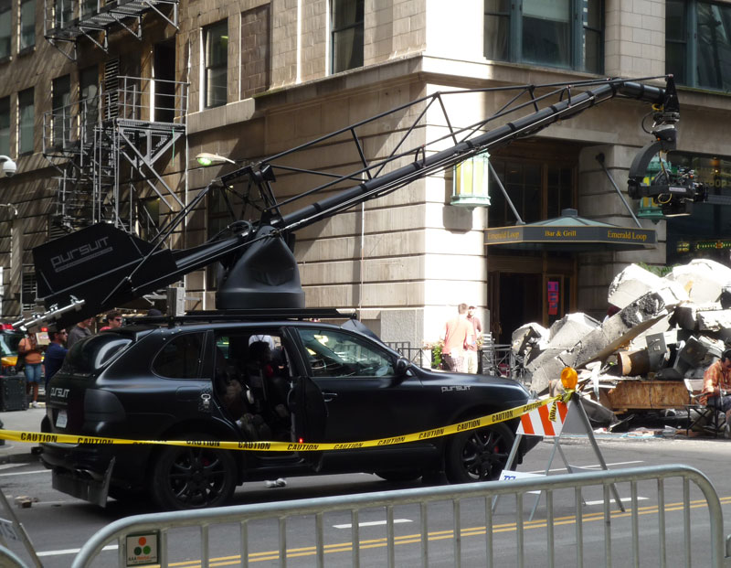
CAMERA MOVEMENTS
Use of Dolly/Tracking and Boom/Crane to shoot “Transformers”

Slide 15
LIGHTING
Used in a similar way to the way in which a writer establishes tone and mood in their work
Lighting creates significant emotional responses from the audience based on what people associate with light and darkness
Lighting effects clarity, realism and emotion

Slide 16
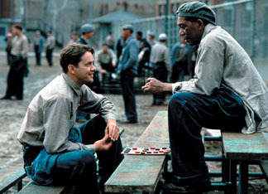
HIGH KEY – the scene is flooded with light; creating a bright and open-looking scene
From the movie “Shawshank Redemption”

Slide 17
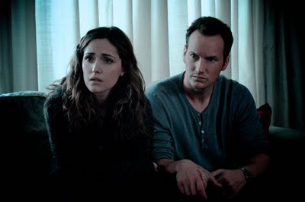
LOW KEY – the scene is flooded with shadows and darkness, creating suspense and suspicion
From the movie “Insidious”

Slide 18
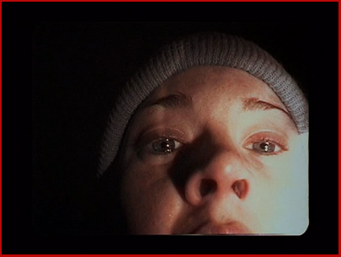
Bottom or Side Lighting – direct lighting from below or the side, which often makes the subject appear dangerous or evil
From the movie “The Blair Witch Project”

Slide 19
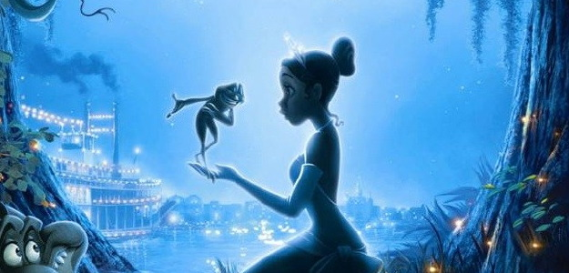
Front or Back Lighting – soft lighting on the actor’s face or from behind which gives the appearance of innocence or goodness, or a halo effect.
From the movie “The Princess and the Frog”

Slide 20
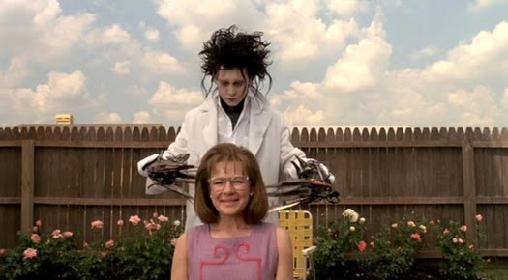
Natural or Artificial Lighting – whether the lighting is natural (comes from a natural source such as the sun) or artificial (comes from an human-made object such as a lamp or computer) can affect the tone of a scene.

Slide 21
Editing Techniques
Used in the same way a writer uses syntax (sentence construction)
Cut – two pieces of film are spliced together to “cut” to another image
Fade – can be to or from black and white; implies the passing of time or the end of a scene
  Fade-In – darkness to brightness
  Fade-Out – image gradually gets darker
Dissolve – a kind of fade in which one image is gradually replaced by another
Wipe – a new image wipes off the previous image (quicker than a dissolve)
Soft Cut – the vision from the first scene continues while the sound from the second scene starts; very common, particularly in TV; the most unobtrusive way of moving between scenes
Shot-Reverse-Shot – a shot of one subject, then another, than back to the first; often used for conversation or reaction shots
Cross-Cutting – cut into action that is happening simultaneously; creates tension or suspense and creates a connection between scenes
Eye-Line Match – cut to an object, then to a person; can reveal a character’s thoughts

Slide 22
Sound
Compares to how a writer establishes tone and mood in their work
Diegetic – sound that can logically be heard by the characters in the film (dialogue, background noise, sound of things in the scene)
Non-Diegetic – sound that cannot be heard by the characters but is designed for the audience reaction only. Includes:
  Narration/Voice over
  Music/Soundtrack
  Sound Effects

Slide 23
Examples of Sound & Editing
The following two clips are useful for demonstrating the importance of sound and editing in film:
Psycho
Jaws

Slide 24
Colour
Colour is extremely important in film as it helps to create tone and atmosphere, as well as being highly symbolic.
It can also be used as way to associate characters with each other, as well as ideas, places, events or objects.

Slide 25
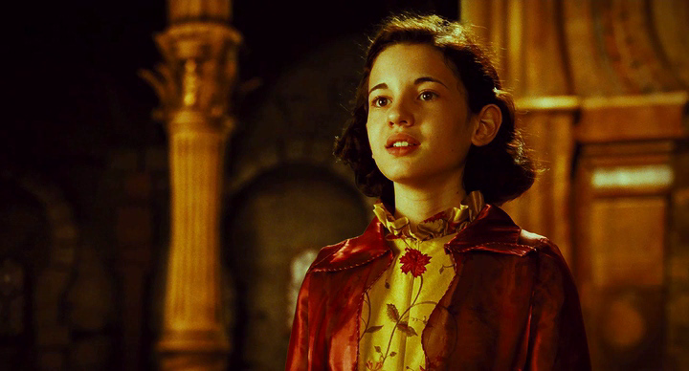
Warm & Bright Colours – are used to create a warm and welcoming atmosphere, as well as create the impression that characters are warm and kind

Slide 26
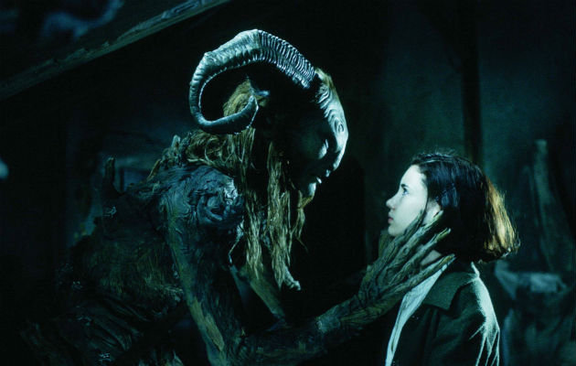
Cool & Dark Colours – can be used to create an atmosphere that is unsettling, tense or scary, as well as characters we might consider as untrustworthy or “bad”.

Slide 27
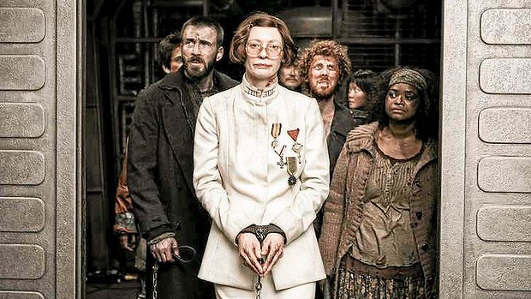
Conflicting Colours – when colours used in a scene seem to “conflict” with each other, it can reflect conflict within characters, either between each other or with what is happening; or, it can reflect the idea that they don’t “fit in”.

Slide 28
Setting
The setting of a film is the where and when of the story.
This is established through the use of location, costume, dialogue and body language.
Different settings can be used to reflect different themes or ideas in the text, for example Paris is the city of love. They can also be used for characterisation; if a character lives in a run-down cottage, they are probably quite poor. Different time periods can be used to help see how things have or haven’t changed over time, or to examine important historical periods; they can also be used to help an audience see the relevance of older texts.

Slide 29
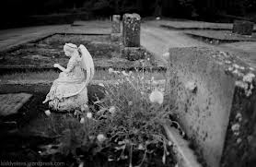
Setting
Setting can also be used to establish atmosphere. This can be particularly important in some genres such as horror or thriller texts.

Slide 30
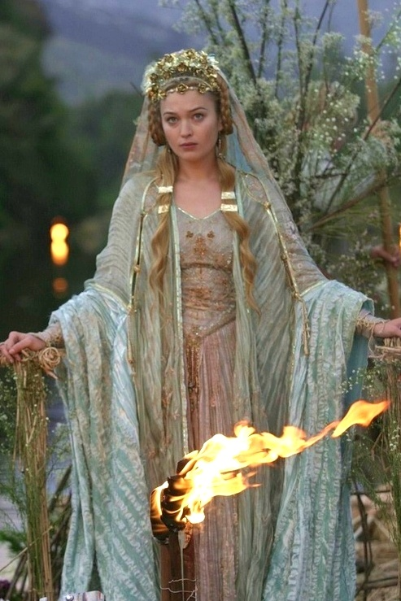
Costumes
Costumes give us important clues about the setting of a film, and can also let us know what genre of film we are watching.
Remember, costuming includes the use of make-up and hairstyles.

Slide 31
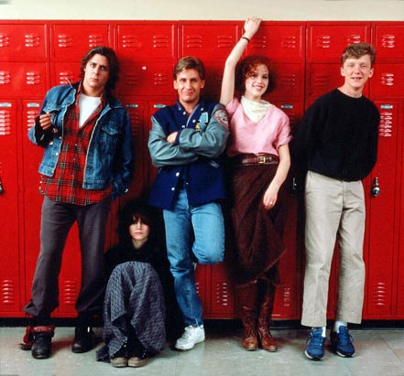
Costumes
Most importantly costumes are used to give us clues about characters, and contributes to characterisation.

Slide 32
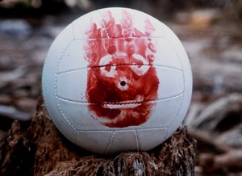
Props (Properties)
A prop is anything used on stage or in a film by an actor; must be portable.
Often contributes to the establishment of setting, and may form part of the set.
Also very important to characterisation, particularly where a character becomes associated with a particular prop; can become symbolic of that character, or a particular idea or theme in the story.

Slide 33
Mise-en-Scene
A French term which originated in the theatre; literally means “in the scene”.
In film terminology it refers to everything that can be seen on screen, as all the elements on screen have been deliberately chosen and have something to say about plot, character and/or setting.
Sets, costumes & props are the most common elements we would refer to in mise-en-scene, however lighting and the use of the camera are also important components.
Look at the following images and comment on what different element of mise-en-scene you notice and what they may be saying.

Slide 34
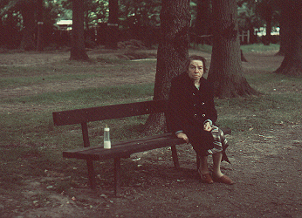

Slide 35
